Slide 1
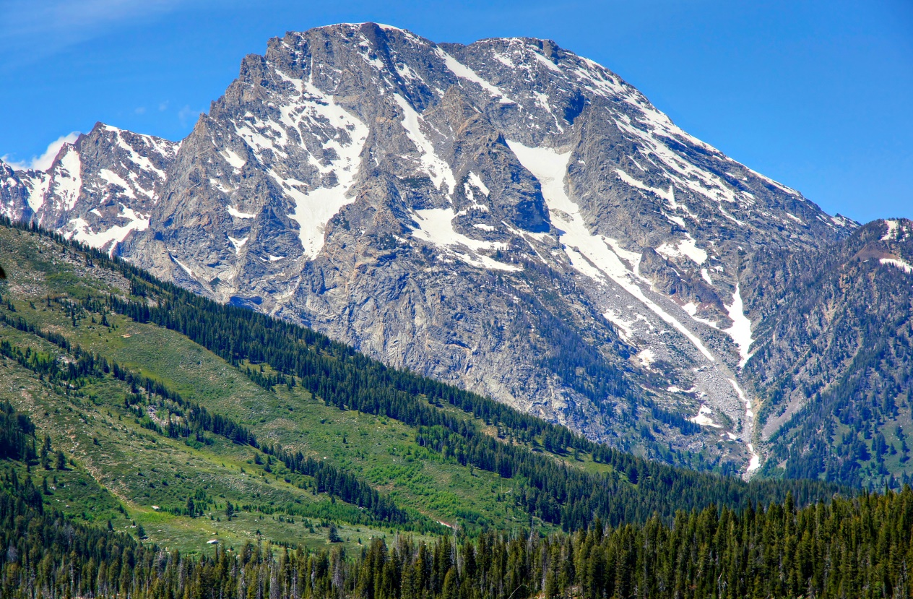
Big Mountain Resort
Big Mountain Resort has recently installed one additional chair lift, increasing operation costs by approximately $1,540,000 per year.

Slide 2

How can this cost be covered?
Big Mountain is considering charging a premium over their standard ticket price of $81 to cover costs.
The premium amount can be justified by comparing new ticket price versus facilities offered when compared to industry standards for resorts in the same market share.

Slide 3
Findings
Big Mountain currently charges $81 per adult ticket. Based on the pricing models, the tickets could be valued at approximately $85. Big Mountain is at the top of their market share for skiiable area and longest run, and even above average for number of runs. Based on the fact that other resorts within the market share charge upwards of $85 while offering less, it is recommended that Big Mountain proceed with charging a premium over $85.

Slide 4

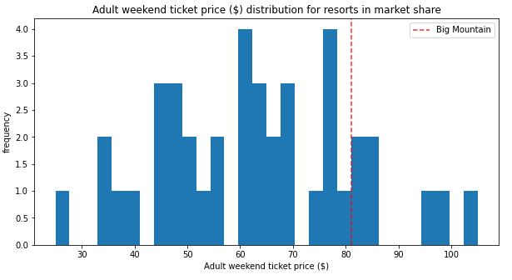
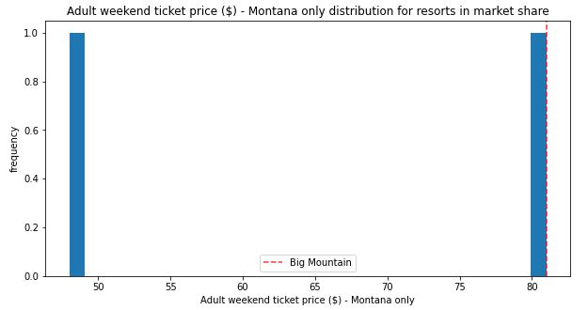
Ticket Prices

Slide 5
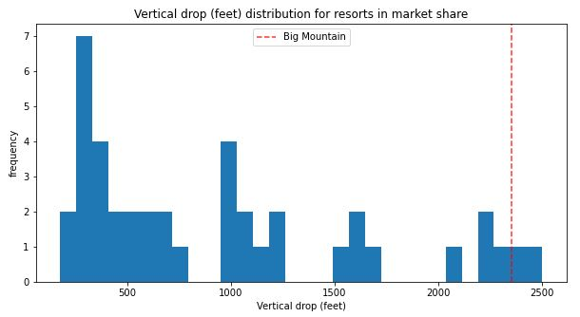
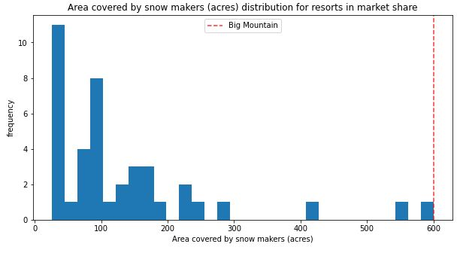
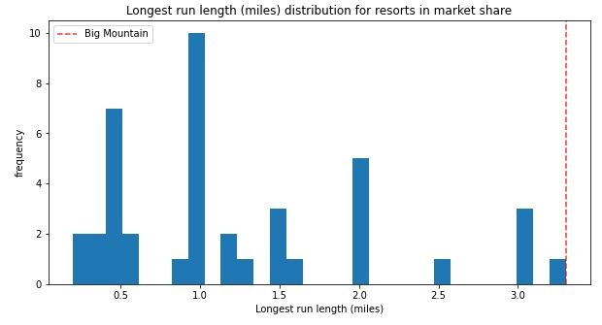
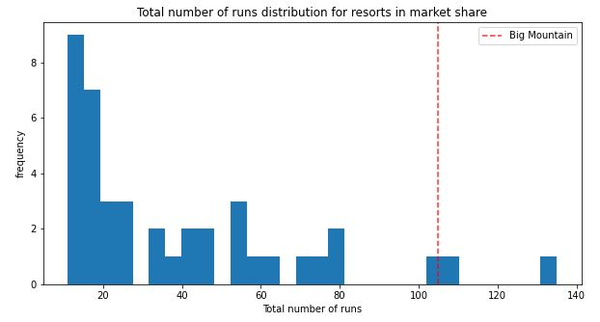
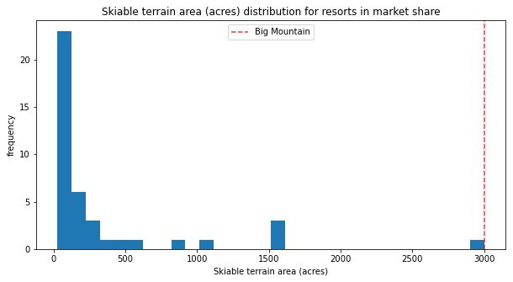
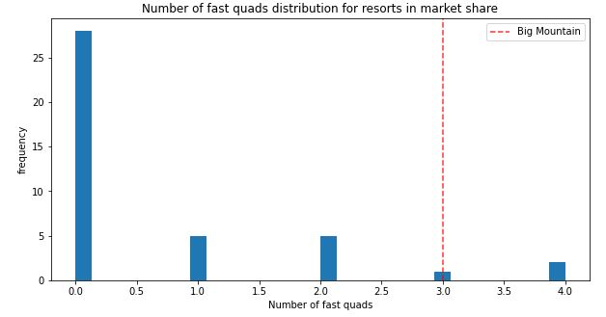
Amenities

Slide 6
Summary/Conclusion
Findings of this investigation indicate that based on average market prices of resorts in the same market share with similar amenities, Big Mountain is justified in raising ticket prices.
Based on the estimated amount of $1,540,000 in operations costs, Big Mountain should raise ticket prices to $86.

